Slide 1

Assessing Impact of Method Entities
in a Special Task
Xiaole Li Yuzhuo Wang
Department of Information Management, Nanjing University of Science and Technology, Nanjing, China

Slide 2
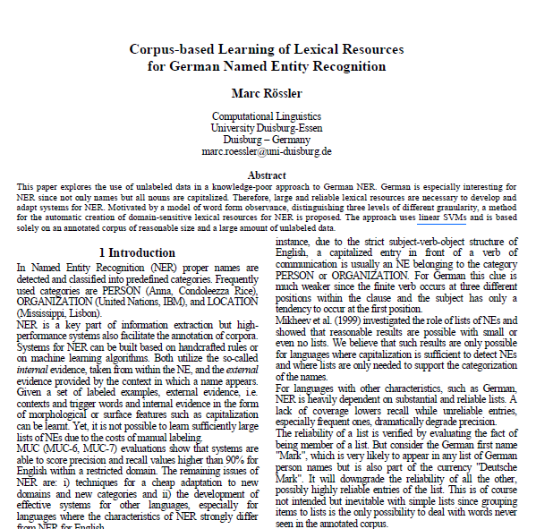

TYPE | EXAMPLE
data source | Wikipedia
algorithm & model | CRF
tool | CRF++
index & measurement | F-measure

Slide 3
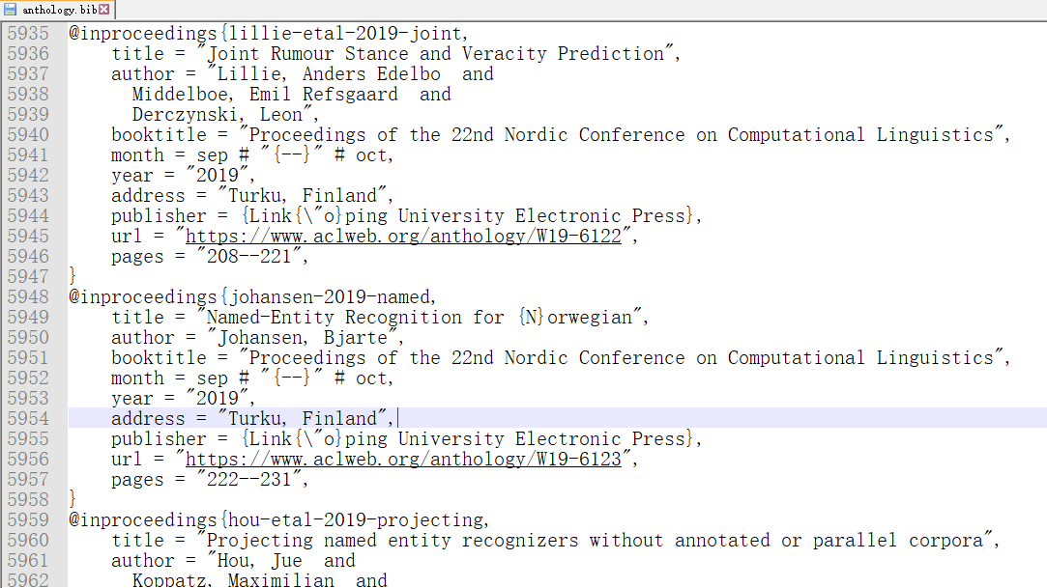
426
Papers
for
Annotating

Slide 4
The method entities annotation result
Type of Entity | Number of Species
Data source | 345
Algorithm & model | 251
Tool | 235
Index & measurement | 73
Total | 904

Slide 5
Top 5 entities in each type entity and the number of papers
Data source | Algorithm & model | Tool | Index & measurement
CoNLL 2003(74) | CRF(194) | CRF++(40) | F-measure(371)
Wikipedia(74) | BiLSTM(72) | OpenNLP(11) | Precision(258)
Twitter(37) | SVM(50) | word2vec(11) | Recall(256)
CoNLL 2002(22) | ME(50) | Stanford CoreNLP(10) | cross validation(55)
MSRA(20) | Viterbi(49) | Twitter API(10) | Accuracy(34)

Slide 9
Assessing Impact of Method Entities in a Special Task
THANKS FOR WATCHING
Xiaole Li Yuzhuo Wang
Department of Information Management, Nanjing University of Science and Technology, Nanjing, China

